Slide 3
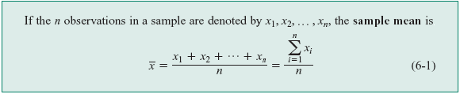














6-1 Numerical Summaries
Definition: Sample Mean

Slide 4
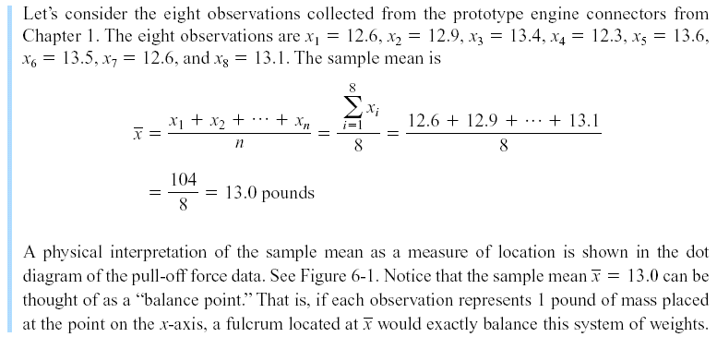
6-1 Numerical Summaries
Example 6-1

Slide 5


6-1 Numerical Summaries
Population Mean
For a finite population with N measurements, the mean is
The sample mean is a reasonable estimate of the population mean.

Slide 6





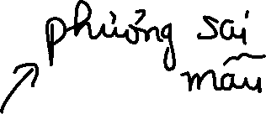




6-1 Numerical Summaries
Definition: Sample Variance

Slide 7
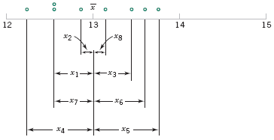
6-1 Numerical Summaries
How Does the Sample Variance Measure Variability?
Figure 6-2 How the sample variance measures variability through the deviations .

Slide 8
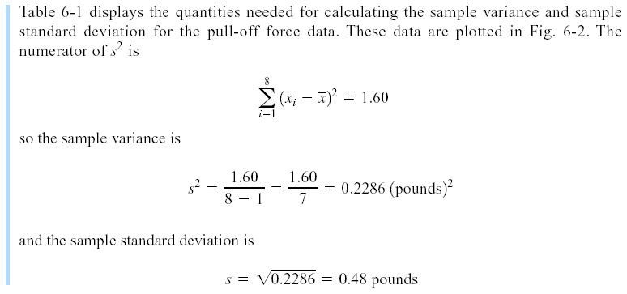
6-1 Numerical Summaries
Example 6-2

Slide 9
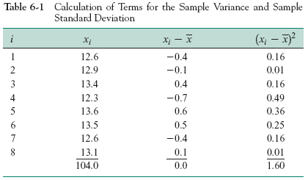
6-1 Numerical Summaries

Slide 10
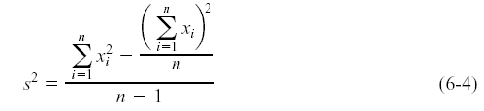








6-1 Numerical Summaries
Computation of s²

Slide 11


6-1 Numerical Summaries
Population Variance
When the population is finite and consists of N values, we may define the population variance as
The sample variance is a reasonable estimate of the population variance.

Slide 12

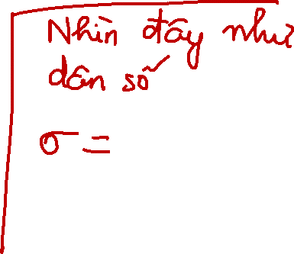





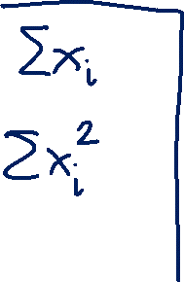






Slide 13

6-1 Numerical Summaries
Definition

Slide 14
6-2 Stem-and-Leaf Diagrams
Steps for Constructing a Stem-and-Leaf Diagram

Slide 15
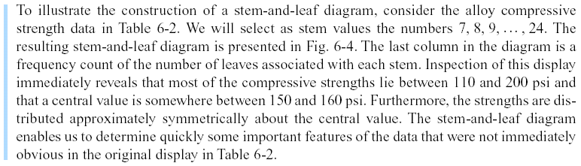
6-2 Stem-and-Leaf Diagrams
Example 6-4

Slide 16
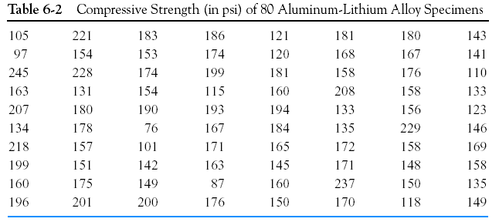
6-2 Stem-and-Leaf Diagrams

Slide 17
6-2 Stem-and-Leaf Diagrams
Figure 6-4 Stem-and-leaf diagram for the compressive strength data in Table 6-2.

Slide 18


















Slide 19
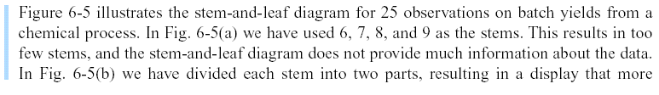
6-2 Stem-and-Leaf Diagrams
Example 6-5

Slide 20
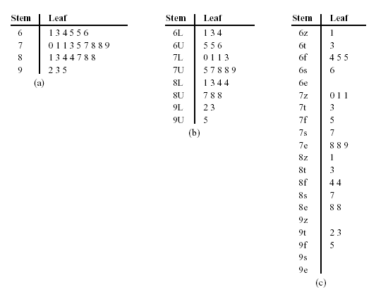
6-2 Stem-and-Leaf Diagrams
Figure 6-5 Stem-and-leaf displays for Example 6-5. Stem: Tens digits. Leaf: Ones digits.

Slide 21
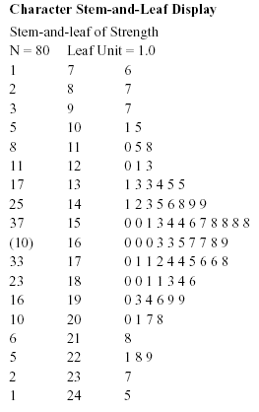
6-2 Stem-and-Leaf Diagrams
Figure 6-6 Stem-and-leaf diagram from Minitab.

Slide 22
6-2 Stem-and-Leaf Diagrams
Data Features
The median is a measure of central tendency that divides the data into two equal parts, half below the median and half above. If the number of observations is even, the median is halfway between the two central values.
From Fig. 6-6, the 40th and 41st values of strength as 160 and 163, so the median is (160 + 163)/2 = 161.5. If the number of observations is odd, the median is the central value.
The range is a measure of variability that can be easily computed from the ordered stem-and-leaf display. It is the maximum minus the minimum measurement. From Fig.6-6 the range is 245 - 76 = 169.

Slide 23


6-2 Stem-and-Leaf Diagrams
Data Features
When an ordered set of data is divided into four equal parts, the division points are called quartiles.
The first or lower quartile, q₁ , is a value that has approximately one-fourth (25%) of the observations below it and approximately 75% of the observations above.
The second quartile, q₂, has approximately one-half (50%) of the observations below its value. The second quartile is exactly equal to the median.
The third or upper quartile, q₃, has approximately three-fourths (75%) of the observations below its value. As in the case of the median, the quartiles may not be unique.

Slide 24


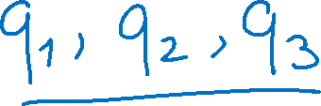







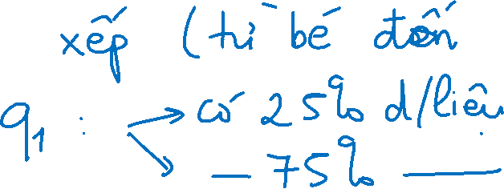

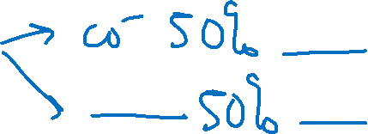

Slide 25


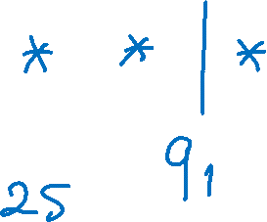

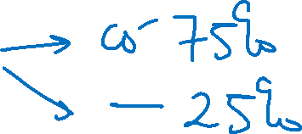
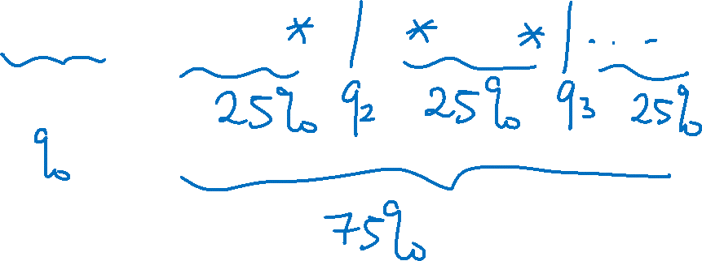


Slide 26

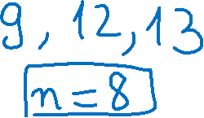






















Slide 27
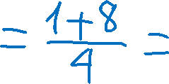
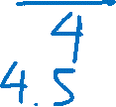
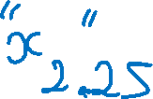








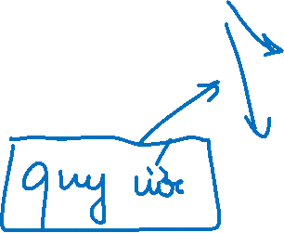

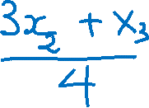
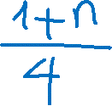



Slide 28
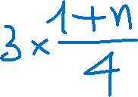






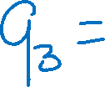


Slide 29


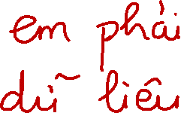






Slide 30
















Slide 31






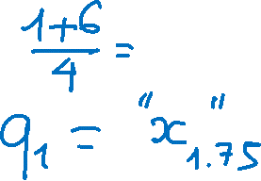




















Slide 32

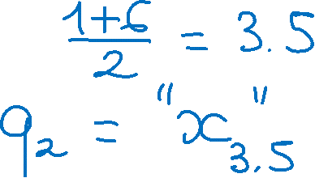




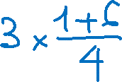










Slide 33







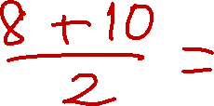












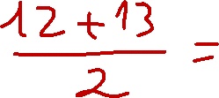

Slide 34










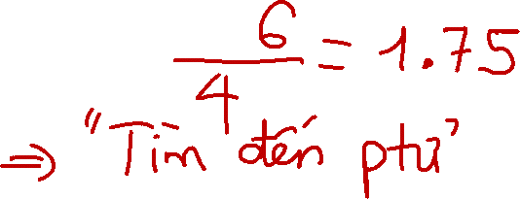











Slide 35







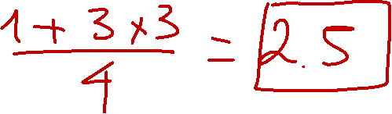

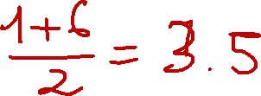


Slide 36





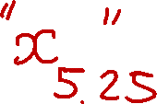
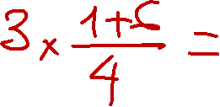
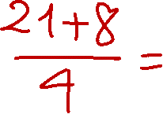

Slide 37
6-2 Stem-and-Leaf Diagrams
Data Features
The compressive strength data in Figure 6-6 contains
n = 80 observations. Minitab software calculates the first and third quartiles as the(n + 1)/4 and 3(n + 1)/4 ordered observations and interpolates as needed.
For example, (80 + 1)/4 = 20.25 and 3(80 + 1)/4 = 60.75.
Therefore, Minitab interpolates between the 20th and 21st ordered observation to obtain q₁ = 143.50 and between the 60th and
61st observation to obtain q₃ =181.00.

Slide 38
















6-2 Stem-and-Leaf Diagrams
Data Features
The interquartile range is the difference between the upper and lower quartiles, and it is sometimes used as a measure of variability.
In general, the 100kth percentile is a data value such that approximately 100k% of the observations are at or below this value and approximately 100(1 - k)% of them are above it.

Slide 39

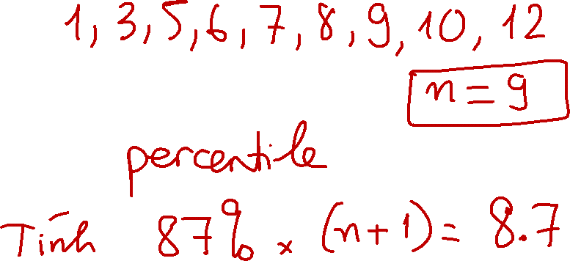



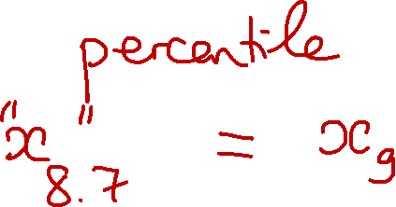
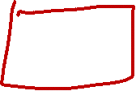


Slide 40











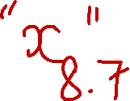









Slide 41

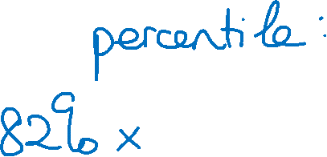













Slide 42








Slide 43
6-3 Frequency Distributions and Histograms
A frequency distribution is a more compact summary of data than a stem-and-leaf diagram.
To construct a frequency distribution, we must divide the range of the data into intervals, which are usually called class intervals, cells, or bins.
Constructing a Histogram (Equal Bin Widths):

Slide 44
6-3 Frequency Distributions and Histograms
Figure 6-7 Histogram of compressive strength for 80 aluminum-lithium alloy specimens.

Slide 45
6-3 Frequency Distributions and Histograms
Figure 6-8 A histogram of the compressive strength data from Minitab with 17 bins.

Slide 46
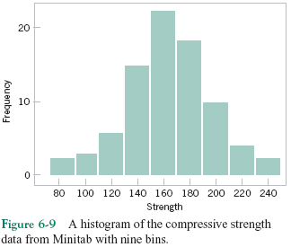
6-3 Frequency Distributions and Histograms
Figure 6-9 A histogram of the compressive strength data from Minitab with nine bins.

Slide 47
6-3 Frequency Distributions and Histograms
Figure 6-10 A cumulative distribution plot of the compressive strength data from Minitab.

Slide 48


6-3 Frequency Distributions and Histograms
Figure 6-11 Histograms for symmetric and skewed distributions.

Slide 49
6-4 Box Plots
The box plot is a graphical display that simultaneously describes several important features of a data set, such as center, spread, departure from symmetry, and identification of observations that lie unusually far from the bulk of the data.
Whisker
Outlier
Extreme outlier

Slide 50








6-4 Box Plots
Figure 6-13 Description of a box plot.

Slide 51



















Slide 52
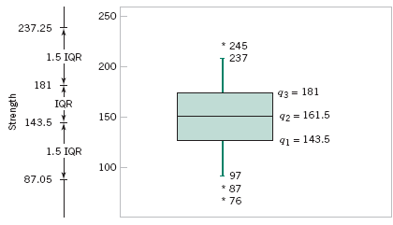
6-4 Box Plots
Figure 6-14 Box plot for compressive strength data in Table 6-2.

Slide 53
6-4 Box Plots
Figure 6-15 Comparative box plots of a quality index at three plants.

Slide 54
6-5 Time Sequence Plots
A time series or time sequence is a data set in which the observations are recorded in the order in which they occur.
A time series plot is a graph in which the vertical axis denotes the observed value of the variable (say x) and the horizontal axis denotes the time (which could be minutes, days, years, etc.).
When measurements are plotted as a time series, we
often see
trends,
cycles, or
other broad features of the data

Slide 55
6-5 Time Sequence Plots
Figure 6-16 Company sales by year (a) and by quarter (b).

Slide 56
6-5 Time Sequence Plots
Figure 6-17 A digidot plot of the compressive strength data in Table 6-2.

Slide 57
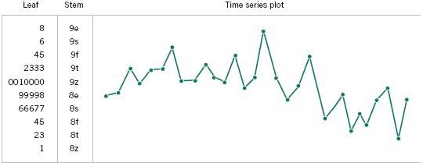
6-5 Time Sequence Plots
Figure 6-18 A digidot plot of chemical process concentration readings, observed hourly.

